Slide 1

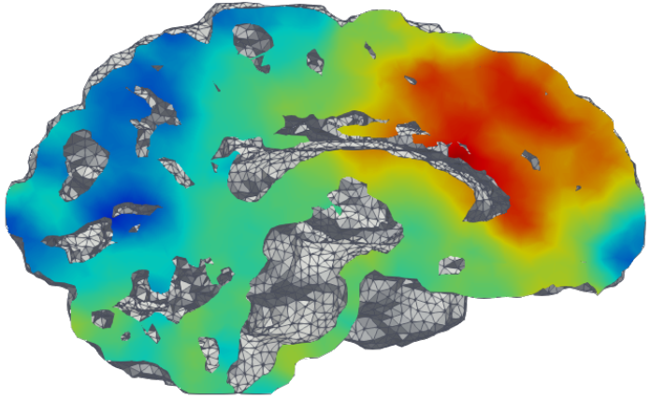
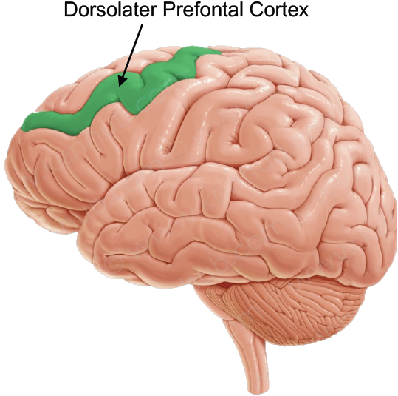
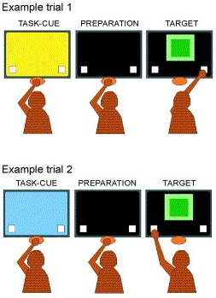
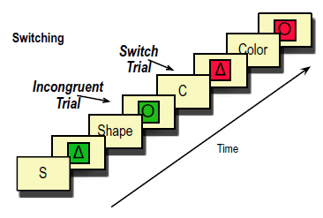

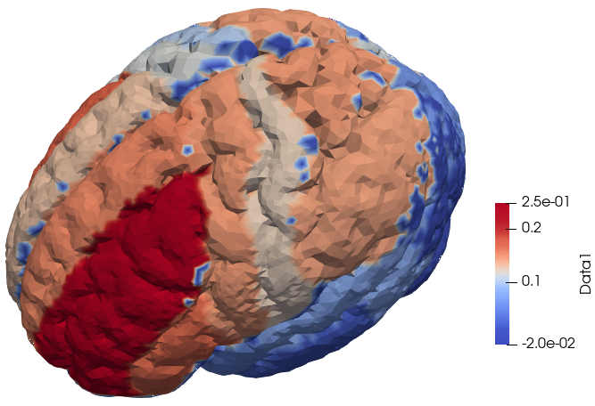

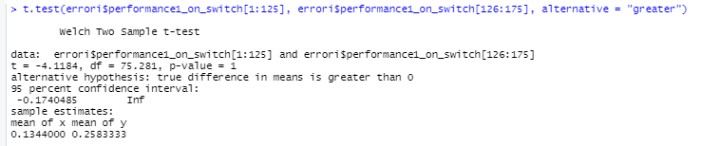
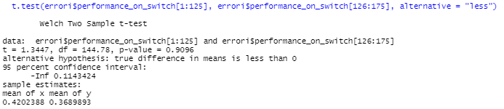
Study case on Human Brain Connectivity: schizophrenia and normal people a confronto Costanza Cantalini, Erica Bistacchia, Lorenzo Ferrara, Scott Pesenti
Presentation of the problem
Our experiment
Our dataset
One of the regions hindered by schizophrenia is the dorsolateral prefrontal cortex (DLPFC) which has been associated to the ability of task switching (TS). Nevertheless, literature suggests that people affected by schizophrenia (SCHZ) do not perform worse than a neuro-typical control population (CTRL). Apparently SCHZ are simply slower in TS, but reach the same tasks’ performances of CTRL. The literature assumes that this latter fact is possibly due to some unknown compensation mechanism in the SCHZ’s brain.
The objective of our project was an exploration of the differences in brain activity between SCHZ and CTRL during TS. To this end we consider the results of the 175 participants subjected to the following test.
The data considered for this work came from an experiment involving 175 participants (125 CTRL and 50 SCHZ). They provided general pieces of information like health, age, BMI, possible comorbidities, smoking habits, and behavioral traits (quantified through the Barratt Impulsivity Test).
While under fMRI, each participant was presented with a series of one of four possible geometric shapes and asked to respond to either the color or the shape of the image based on the task cue presented prior to, and above, the image. On 25% of trials the instructions switched, i.e., participants were instructed to switch from responding from shape to color, or vice versa.
BISOGNA SPIEGARE COSA VUOL DIRE SWITCH,CONFRUENT E CHE ABBIAMO ANCHE ID ATI RELATIVI ALA CORRETETZA DELLE
Consequently, three sets of data were gathered for each participant:
Covariates, which included all the health-related data.
Z-map, a table of >36000 values, each corresponding to a node of the brain mesh on which the fMRI data was projected
Event recordings, a time step dataset composed of all the readings from the test, such as: reaction time, cue, answer.
In particular, we kept only age and BMI of the covariates data, as the other ones were mainly missing or not consistent.
Preliminary exploration of the dataset
Analyses of the performances
We checked whether the data basic statistics matched the literature and we identified the regressors that are statistically significant w.r.t. reaction time:
The performance of each participant is measured through the following four indexes (see Fig.9867):
Switch cost: mu_switch - mu_noSwitch = mean time during switch trials - mean time during nonswitch trials
Correct cost: mu_correct - mu_errors = mean time during correct trials- mean time during noncorrect trials
General accuracy rate: #correct/#total
Switch accuracy rate: #correctOnSwitch/#Switch
The analysis of the available dataset and of the above four indexes was performed as follows:
we carried on an analysis of the Switch Costs and Correct Costs,
an ANOVA
an analysis of error/accuracy rates.
General difference
PSYCHOLOGICAL TRAITS, BARRATT IMPULSIVENESS SCORES
BMI AGE
We performed a t-test on the means confirmed a significative difference in the distributions of the Reaction Times in CTRL and SCHZ (see Fig. 1).
ABBIAMO UN PVALUE DEL ??
We performed a t-test on the Scores of the Barratt Impulsivity Test (BIS) confirmed a significant difference between the means of SCHZ and CTRL scores (see Fig. 2).
Abbiamo un pvalue del ??
And then we proceeded using the following Linear Regression Models (LRM)
Reaction.Time ~ BIS.
Finally we explored the relation between health covariates and Reaction times using the LRM:
Reaction.Time ~ Age + BMI + Diagnosis + Age:Diagnosis + BMI:Diagnosis
Only age and Diagnosis resulted as the only statistically significant regressors (see Fig 5) and no interaction seems to be important.
dovremmo mettere vicini i due blu e i due arancioni?
MANCA IL TEST PER LA DIFFERENZA
MANCA IL TEST PER LA DIFFERENZA
The Box plots in Fig. 4782 indicated that both the differences in accuracy rate and accuracy on switch between CTRL and SCHZ are statistically significant. In particular, the SCHZ accuracy rate is lower than the CTRL one. On the other hand, the SCHZ accuracy on switch is higher than the CTRL one.
In addition, the same Box plots also indicated that the differences in accuracy rate and accuracy on switch of CTRL is statistically significant. This fact does not hold true for the SCHZ.
The previous results falsifies what has been proposed in literature. It appears that no compensating mechanism is necessary as the accuracy rate of SCHZ is lower than CTRL but seems independent of task switching.
BIS did not turn out a statistically significant regressor, despite the previous results of the T-test on the BIS scores.
ANOVA
CONSIDERATIONS ABOUT ACCURACY
PRINCIPAL COMPONENT ANALYSIS
CONCLUSIONS
An ANOVA on the mean of the reaction times of each participant according to different conditions of the experiment:
Reaction.time ~ diagnosis + congruent + switch + diagnosis*congruent + diagnosis*switch + congruent*switch
showed a high significance of diagnosis and switch, but no interaction was statistically significant. A stepwise reduction led us to the additive model:
Reaction.time ~ diagnosis + switch (see Fig. 46).
DA SCCRIVERE MEGLIO Paired with the results from the LRM in the preliminary analysis and the Box Plots in the analysis of switch costs we can state that the difference between Switch Costs for SCHZ and CTRL are not statistically significant, switching seems not to hinder SCHZ’s reaction time more than CTRL.
LMM

